Slide 1
Binary Search Tree
  Introduction to BST
  Operations of BST
  Traversals
  Searching
  Insertion; and
  Deletion

Slide 2
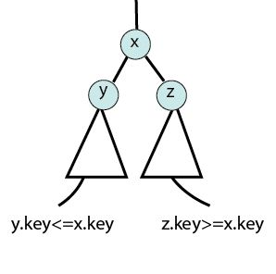
Binary Search Tree
Binary search tree is a binary tree where each node has a comparable key that satisfies some property. Let x be a node in a binary search tree.
  If y is a node in the left subtree of x, then y.key<=x.key.
  If z is a node in the right subtree of x, then z.key>=x.key

Slide 3
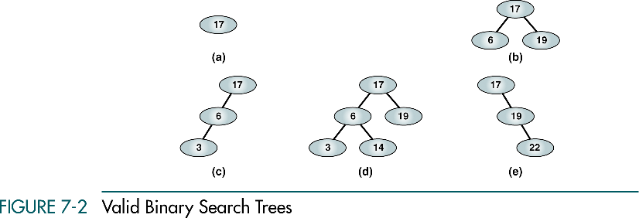
Binary search trees
Some example of valid Binary search tree:
(a), (b) - complete and balanced trees;
(d) – nearly complete and balanced tree;
(c), (e) – neither complete nor balanced trees

Slide 4
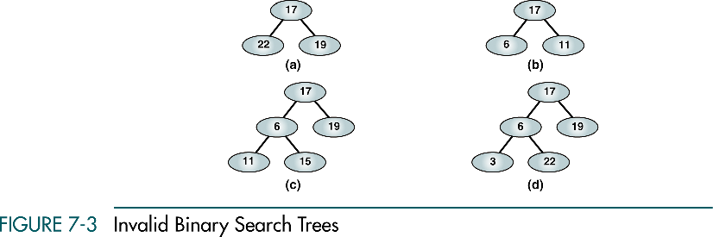
Binary search trees
Some example of invalid Binary search tree:

Slide 5
Applications
Used in many search applications where data is constantly entering/leaving, such as the map and set objects in many languages' libraries.
It is used to implement dictionary.
It is used to implement multilevel indexing in DATABASE.
They can be used to represent arithmetic expression.
Used in Unix kernels for managing a set of virtual memory areas (VMAs)

Slide 6
Binary Search Trees Operations
Traversals
Searches
Insertions
Deletions

Slide 7
Traversals

Slide 8
Traversals
Preorder
Inorder
Postorder

Slide 9
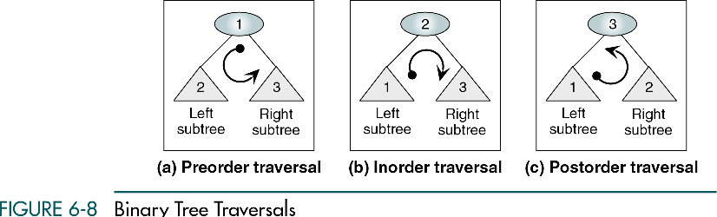
Binary Search Tree Traversals

Slide 10
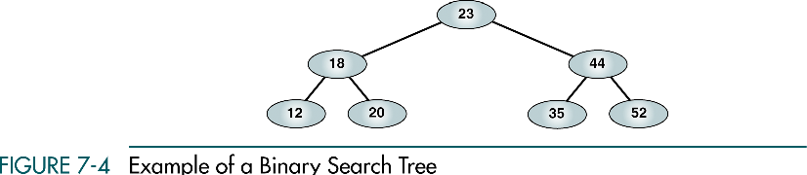
Example of a Binary Search Tree

Slide 11
Binary Search Trees
Preorder Traversal:
23 18 12 20 44 35 52

Slide 12
Binary Search Trees
Inorder Traversal:
12 18 20 23 35 44 52

Slide 13
Binary Search Trees
Postorder Traversal:
12 20 18 35 52 44 23

Slide 14
Binary Search Tree Traversals
Preorder
Inorder
Postorder
Inorder Traversal of a binary search tree produces a sequenced list

Slide 15
Inorder Traversal
Algorithm:
Inorder-Tree(x)
If(x!=null)
Inorder-Tree(x.left)
print x.key
Inorder-Tree(x.right)

Slide 16
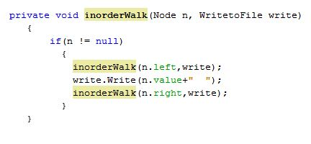
Inorder Traversal
Implementation in program:

Slide 17
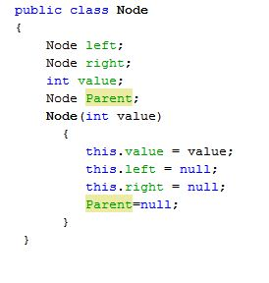
Inorder Traversal
Implementation in program:

Slide 18
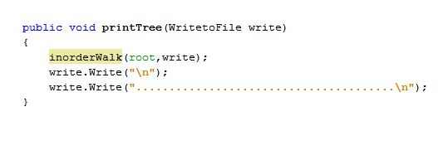
Inorder Traversal
Implementation in program:

Slide 19

Inorder Traversal
Input:

Slide 20
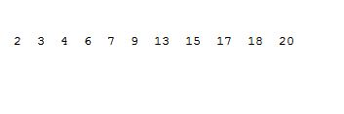
Inorder Traversal
Output:

Slide 21
Complexity of Inorder Traversal
Time complexity = O(height of the tree)

Slide 22
Searching

Slide 23
Searches
Three search:
Find a requested node
Find the smallest node
Find the largest node
MINIMUM, MAXIMUM, SUCCESSOR, and PREDECESSOR
Tree Successor

Slide 24
Searching a requested node

Slide 25
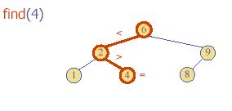
Searching a requested node

Slide 26
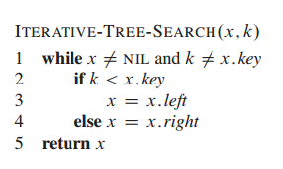
Searching a requested node
Algorithm:
Tree-Search(x,k)
If(x==NILL or k==x.key)
return x
If(k<x.key)
return Tree-Search(x.left,k)
Else
returnTree-Search(x.right,k)

Slide 27
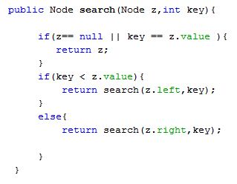
Searching a requested node
Implementation in program:

Slide 28
Searching a requested node
Implementation in program:

Slide 29
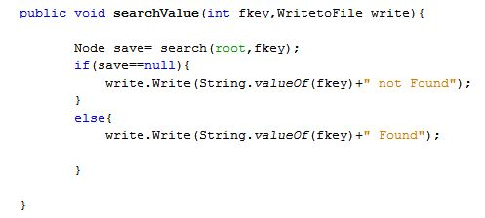
Searching a requested node
Implementation in program:

Slide 30
Searching a requested node
Input:

Slide 31
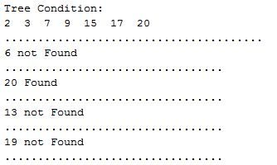
Searching a requested node
Output:

Slide 32
Complexity: Requested node Searching
Time complexity = O(height of the tree)

Slide 33
Searching a smallest node

Slide 34
Searching the smallest node
Algorithm:
Tree-Minimum(x)
While(x.left!=NILL)
x=x.left
return x

Slide 35
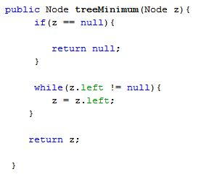
Searching the smallest node
Implementation in program:

Slide 36
Searching the smallest node
Implementation in program:

Slide 37
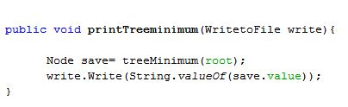
Searching the smallest node
Implementation in program:

Slide 38
Searching the smallest node
Input:
Maximum

Slide 39

Searching the smallest node
Output:
tree

Slide 40
Complexity: Smallest node Searching
Time complexity = O(height of the tree)

Slide 41
Tree Successor

Slide 42
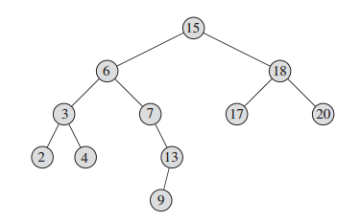
Successor
The successor of the node with key 15 is the node with key 17, since it is the minimum key in the right subtree of 15

Slide 43
3 conditions to find successor
If the node X has right subtree
If the node X doesn’t have right subtree
  Node is in the right subtree part of root
If the node X doesn’t have right subtree
  Node is in the left subtree part of root

Slide 44
Tree Successor
Algorithm:
Tree-Successor(x)
if(x.right!=NILL)
return Tree-Minimum(x.right)
y=x.p
While(y!=NIL && x==y.right)
x=y
y=y.p
return y

Slide 45
Tree Successor
Find Successor:23

Slide 46
Tree Successor
The Successor of 23 is 35

Slide 47
Tree Successor
The Successor of 20 is 23

Slide 48
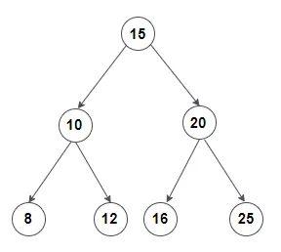
Exercise
Find the successor of node 8, 12, and 25:
Notes:
Ans: 10; 15; and 15

Slide 49
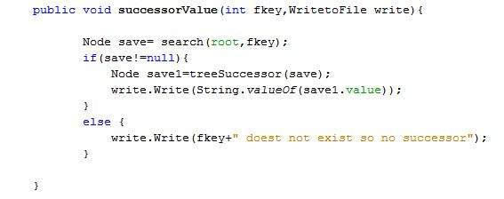
Tree Successor
Implementation in program:

Slide 50
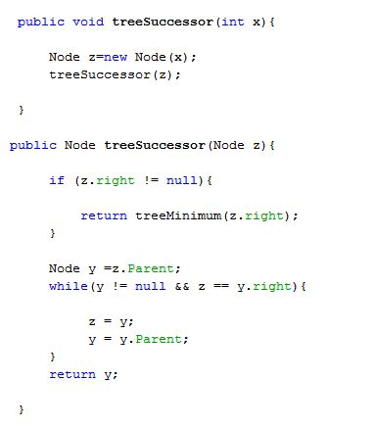
Tree Successor
Implementation in program:

Slide 51
Tree Successor
Input:

Slide 52

Tree Successor
Output:
tree

Slide 53
Complexity: Tree Successor
Time complexity = O(height of the tree)

Slide 54
Searching a largest node

Slide 55
Searching the largest node
Algorithm:
Tree-Maximum(x)
While(x.right!=NILL)
x=x.right
return x

Slide 56
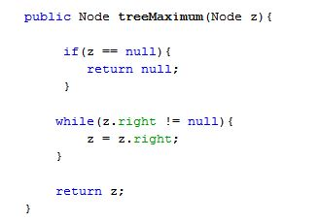
Searching the largest node
Implementation in program:

Slide 57
Searching the largest node
Implementation in program:

Slide 58
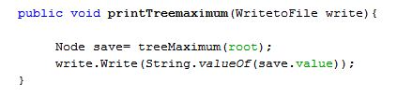
Searching the largest node
Implementation in program:

Slide 59
Searching the largest node
Input:
Maximum

Slide 60

Searching the largest node
Output:
tree

Slide 61
How do you find predecessor?
Ans: Do similar fashion that we did in successor, but in reverse direction i.e. consider the left subtree.

Slide 62
Complexity: Largest node Searching
Time complexity = O(height of the tree)

Slide 63
Insertions

Slide 64
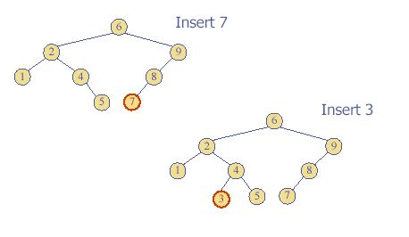
Insertions

Slide 65
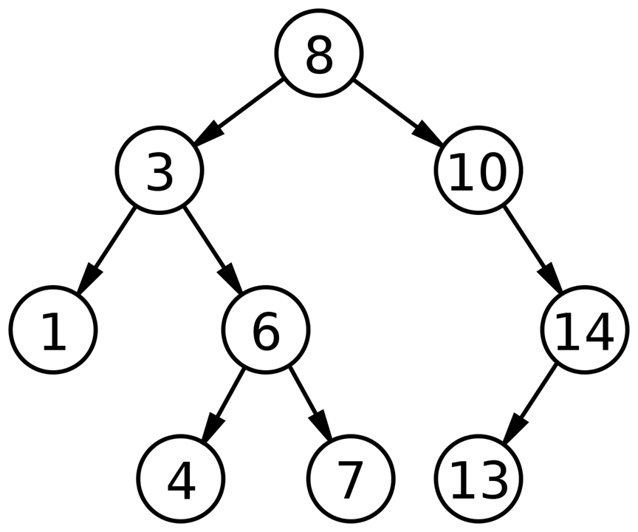
Exercise
Insert a node 12 in the following BST:

Slide 66
Insertions
Algorithm:
Tree-Insert(T,z)
Y=NILL
X=T.root
While(x!=NIL)
y=x
if(z.key<x.key)
x=x.left
else x=x.right
z.p=y
If(y=NIL)
T.root=z
Else if(z.key<y.key)
y.left=z
else y.right=z

Slide 67
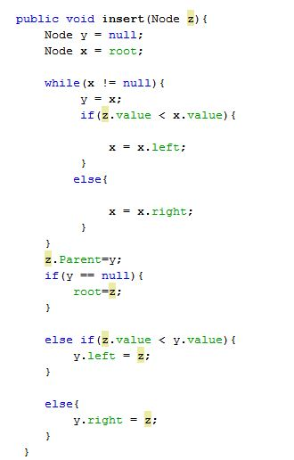
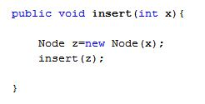
Insertion
Implementation in program:

Slide 68
Insertion
Implementation in program:

Slide 69
Insertion
Input

Slide 70
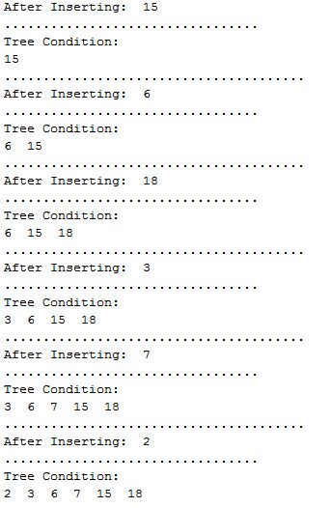
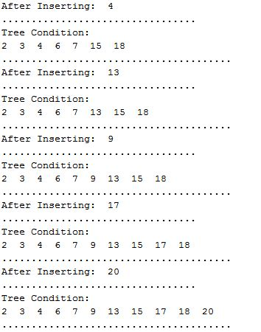
Insertion
Output

Slide 71
Complexity: Insertion
Time complexity = O(height of the tree)

Slide 72
Deletions

Slide 73
Deletions
When we delete a node, we need to consider how we take care of the children of the deleted node.
  This has to be done such that the property of the search tree is maintained.

Slide 74
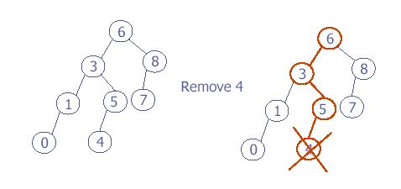
Deletions
Three cases:
(1) the node is a leaf
  Delete it immediately

Slide 75
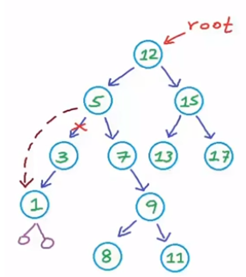
Deletions
(2) the node has one left child
  Adjust a pointer from the parent to bypass that node

Slide 76
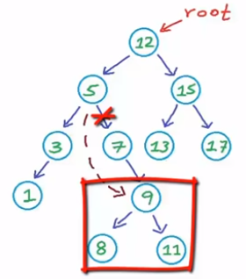
Deletions
(2) the node has one right child
  Adjust a pointer from the parent to bypass that node

Slide 77
Deletions
3) the node has 2 children
  replace the key of that node with the minimum element at the right subtree
  delete the minimum element
    Has either no child or only right child because if it has a left child, that left child would be smaller and would have been chosen. So invoke case 1 or 2.

Slide 78
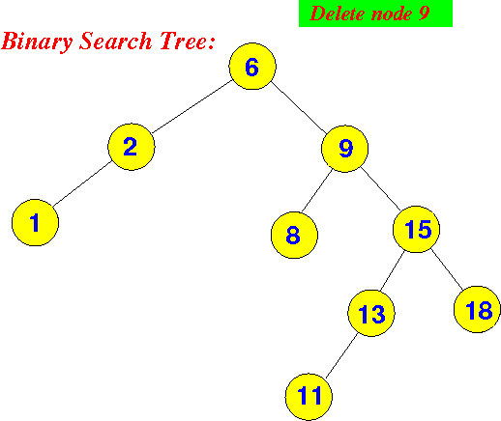
Deletion a node having 2 children

Slide 79
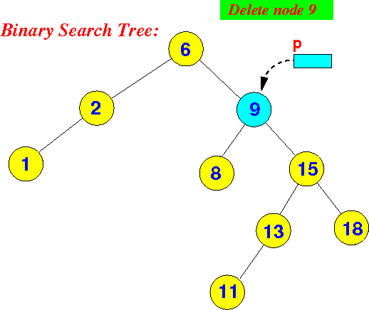
Deletion: 2 children
First, we must find the node with the value 9:

Slide 80
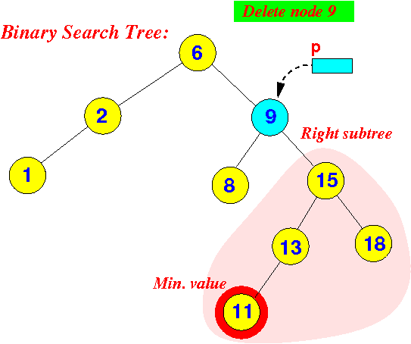
Deletion: 2 children
Next, we find the successor node of the node 9. The successor node is the node with the minimum value in the right subtree:

Slide 81
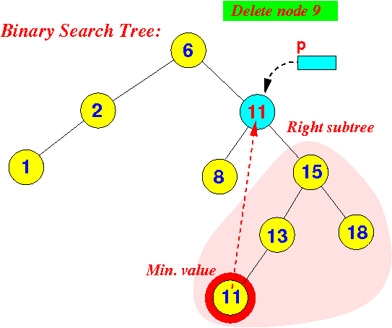
Deletion: 2 children
We copy the content of the successor node of the node into the deletion node (p):

Slide 82
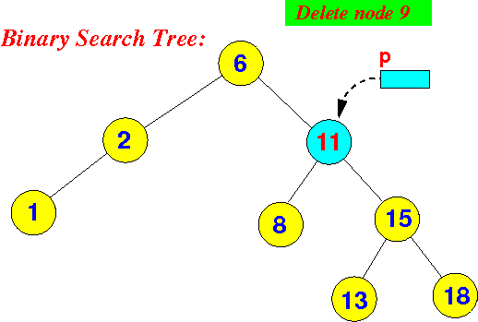
Deletion: 2 children
The last step is deleting the successor node from the BST and setting all parent and children:

Slide 83
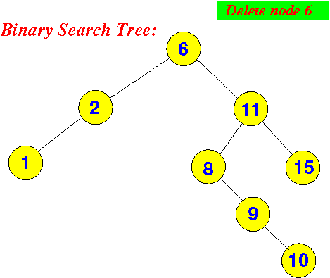
Exercise-1
Delete the node 6 represented in the tree:

Slide 84

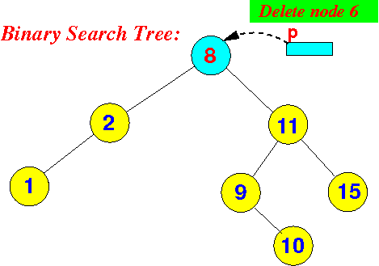
Final Tree: Exercise-1

Slide 85
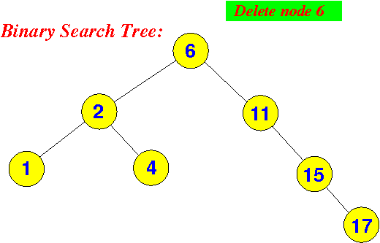
Exercise-2

Slide 86
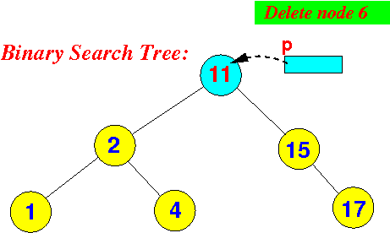
Final Tree: Exercise-2

Slide 87
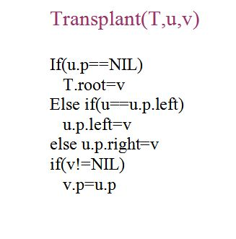
Deletions
Algorithm:
Tree-Delete(T,z)
if(z.left==NIL)
Transplant(T,z,z.right)
else if(z.right==NIL)
Transplant(T,z,z.left)
else y=Tree-Minimum(z.right)
if(y.p!=z)
Transplant(T,z,z.left)
y.right=z.right
y.right.p=y
Transplant(T,z,z.left)
y.left=z.left
y.left.p=y

Slide 88
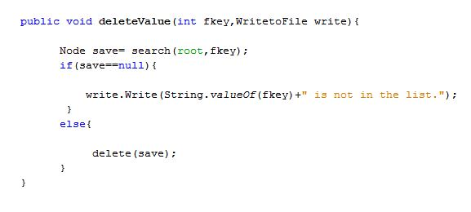
Deletions
Implementation in program:

Slide 89
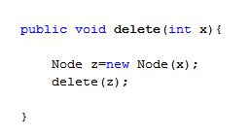
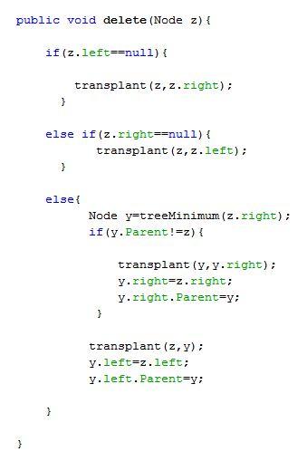
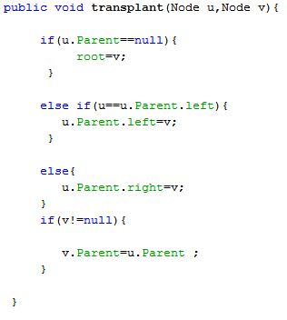
Deletions
Implementation in program:

Slide 90
Deletions
Input

Slide 91
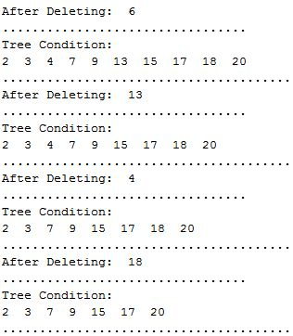
Deletions
Output
tree

Slide 92
Complexity: Deletions
Time complexity = O(height of the tree)

Slide 93
References
Corman Book: chapter 12
Constructing a Binary Search Tree from an array: https://www.youtube.com/watch?v=FvdPo8PBQtc
https://www.youtube.com/watch?v=gcULXE7ViZw

